Slide 1
Presenter Name
Presenter Title
SAVVY WOMEN, SMART INVESTORS
Take charge of their financial future
MFS does not provide legal, tax or accounting advice. Clients of MFS should obtain their own independent tax and legal advice based on their particular circumstances.
You should recommend products based on your client's financial needs, goals, and risk tolerance. The views expressed in this presentation are those of MFS and are subject to change at any time. These views should not be relied upon as investment advice, as securities recommendations, or as an indication of trading intent on behalf of any other MFS investment product.
MFS Fund Distributors, Inc. may have sponsored this seminar by paying for all or a portion of the associated costs. Such sponsorship may create a conflict of interest to the extent that the broker dealer's financial advisor considers the sponsorship when rendering advice to customers.
MFS Fund Distributors, Inc. Boston, MA
NOT FDIC INSURED • MAY LOSE VALUE • NO BANK GUARANTEE
40242.6

Slide 2
Women have choices and unique challenges
Be financially aware and confident:
Know financial matters at each life stage
Navigate them successfully
Recognize women’s unique financial challenges
Get help when you need it
Notes:
Hello! My name is [name and title]. Welcome to our presentation Savvy Women, Smart Investors. Think of this as a sort of journey, where you’ll learn about key financial matters at each stage of your life and how to navigate them. Along the way, you’ll see the unique financial challenges we face as women, learn what questions to ask and be able to get help answering them.
This isn’t about having all the answers. It’s about women’s financial awareness and confidence. By the time we’re done, we’re really hoping to boost yours!

Slide 3
What Keeps You Up At Night ?
Early Life Stage
Mid Life Stage
Later Life Stage
Paying off college debt
Finding a job
The future
Career
Marriage and finances
Caring for child, ill spouse, parent or sibling
Retirement
Everything
Health care
Social Security
Outliving money
Notes:
So, before we begin our journey, here’s a brief roadmap to where we’re going. We’ll be looking at women’s financial concerns during the early, mid and later life stages. As you can see, there’s a lot to think about and balance in each of these stages.
Remember, though, while you’re in charge of your financial journey, you’re never alone. No matter how old you are or what life stage you’re in, a financial advisor can help you navigate the financial opportunities and challenges in front of you.
One of the reasons women have so many more choices and challenges today is so much has changed about the way we live our lives…

Slide 4
That was then…
The 1950’s: The Good Housewife
Women supported the family through caregiving
Notes:
Turn the clock back nearly seven decades, and a woman’s role was clearly defined. The image you see is an actual excerpt from a 1950s home economics book and the message was clear: be a good housewife and homemaker, and have dinner waiting for your husband when he comes home from work.
Lucky for us, 1970 brought the women's movement to life. That decade was a game changer during which women challenged traditional roles and rules, and entered the workforce in bigger numbers.

Slide 5
This is now
49%
Are their family's primary breadwinner¹
51%
Of women are in management or professional occupations²
Now women support their family and the bottom line
¹NBC, WSJ Polls, March 2018 ²U.S. Bureau of Labor Statistics, Current Population Survey, U.S. Household Data, Table 11, 2018
Notes:
As a result, women’s roles today are a lot more varied and much less defined. So many more of us are working. In fact:
49% of women are their family's primary breadwinner.
51% are employed in management or professional occupations.
And those numbers will continue to grow as women become a bigger part of the workforce. Given their positions today and more significant earning power, more and more women are involved in their personal and family finances. They’re also taking charge of their investments and planning for key financial goals.
So it’s really more important than ever that women know what could come up financially at every life stage.

Slide 6
Starting out: early life stage
Notes:
Let’s start with early life – maybe your 20s to your 30s. At this point, you might have student debt to pay, a job to find and your future to figure out…

Slide 7
Care for your credit
What impacts your credit score
Keeping a healthy credit score
Amount you owe on current loans
Interest rates on current debt
Payment history
Length of credit history
Credit mix
Current salary
Pay bills on time – set up automatic payments
Keep credit card balances low
Open credit only when needed
Check your credit score once a year – it’s free
Credit Karma.com
Annual Credit Report.com
Current salary
Healthy credit creates buying power
Notes:
Be sure to start off on the right financial foot, by establishing good credit and taking great care of it. If you take on too much debt, it could be hard to rent an apartment, buy a home, get a loan or even get a job! Also, a bad credit score could prevent you from getting approved for a cell phone contract or even buying a car.
What factors into your credit score? <Read slide>
How do you keep your credit healthy? <Read slide>

Slide 8
Make a Budget
Follow the 50/30/20 rule
50%
Necessities
30%
Wants
20%
Financial Goals
Always know your cash flow
Notes:
Reducing your debt can also help improve your credit. One way you can do that and keep your finances in order is to create a budget.
We consider following the 50/30/20 rule.
50% of your income goes to housing, food and other household necessities.
30% goes to wants such as traveling, morning coffee, etc.
20% should be used to help achieve your financial goals such as saving for retirement

Slide 9
Brush up on benefits
Take advantage of what your employer offers
Retirement plan
401k company match
Vesting period
Health insurance coverage
Maternity, Paternity, Adoption leave
Tuition reimbursement
Student loan repayment assistance
Don’t miss out on more in your pocket
Notes:
So saving is about doing something for yourself. What about getting what you’re worth from others – like an employer? When you go to apply for your first job, or even switch jobs, be sure you understand all of the benefits offered by the employer. Many companies are increasing their employer benefits options in order to recruit and retain new talent.
Again, think about your bottom line. An employer who offers a company match, generous paid maternity/paternity leave, or educational assistance like tuition reimbursement or help repaying student loans could help you strengthen your finances and set you up for future life events.
There is definitely a growing trend towards workplace benefits geared for millennials, such as student loan repayment assistance, onsite cafes, dog-friendly offices, relocation and travel privileges, improved leave policies, free snacks and more. (Source: Fit Small Business Employment Survey, 2017.)
Just be sure you know what benefits are available and contact your HR department with any questions so you can take full advantage of them.

Slide 10
The juggling act: middle life stage
Notes:
One of the reasons it’s so important to build good financial habits in the early life stage is they’ll help you juggle money matters once you reach middle life.
That’s the time when career moves, marriage, having kids, caring for a spouse, parent or other family member along with saving for education and retirement all seem to come together in one financial melting pot.
So let’s talk about how to navigate some of those concerns and keep your cool.

Slide 11
Merging Finances After Marriage
Talk to your partner about financial goals
Consider a prenuptial agreement
Compare your credit scores, savings and spending habits
Discuss how much would you spend without telling the other spouse
Create a budget for present and future needs
Work toward long-term savings goals
Update beneficiary information
Communicate, collaborate and compromise
Notes:
One of the big financial matters that comes at mid life is how to manage money as a married couple. The most important thing to do here is work together and communicate. The checklist you see on screen can help you start a conversation with your spouse and serve as a framework for a conversation with your financial advisor
You don’t have to agree on all things money-related but it’s critical to be open and find some common ground – like how much you can spend without asking each other’s permission. Talk about your financial goals and share your views on credit, saving and spending. Even if one of you is a saver and the other is a spender, try to reach a compromise that makes you both feel like you have a say in what you do with your money. Create a budget together for present and future needs – that will help you build toward your long-term goals.
Work out logistics and any agreements/paperwork you need. Sometimes a prenuptial agreement might make sense, depending on who came into the marriage with what assets. And at all times your legal documents, like wills, trusts and beneficiary designations should be up to date. This is another place where a financial advisor could be invaluable. He or she can go through your assets and assemble a team of professionals like tax and legal professionals, to help you put together your estate plan.

Slide 12
Flying solo
Fully support your single self
Source: New York Magazine, The Single American Women, February 22-March 6, 2016 Issue
Fortify your finances
Notes:
There is a lot to think about when it comes to marriage and finances, but what if you’re single? These days, that’s true for more and more women in the US. Consider that:
In 2009 the proportion of American married women dropped 50%
First time in American history single women outnumbered married women
Number of adults younger than 34 never married was up 46% (Rising 12 percentage points in less than a decade)
In 2016 only 20% of Americans ages 18-29 were married compared to 60% in 1960 (Source: New York Magazine, The Single American Women, February 22- March 5, 2016 Issue)
If you’re a single women, you’re probably relying on just one income, so having some emergency cash stashed away is really important. If you don’t have life insurance, consider getting it. Even if you don’t have dependents, you don’t want your expenses to burden other family members and life insurance could help prevent that. You also need to plan ahead for your long-term healthcare expenses to avoid burdening your family with these costs. To get started, consider 1) a long-term care plan or apply for long-term care insurance ; and 3) revisit your beneficiaries. Then maybe partner with a financial advisor who can help you with other strategies such as HSAs (Health Savings Account) or looking at your long-term care insurance options.

Slide 13
The goal: max out your 401k
Save for your future self…she may need it
Contributions
Start contributing at age 22
6% initial savings rate
50% employer match up to 6%
Auto-escalate 1% per year up to 10%
Hypothetical investment gains
7.5% return
Pre-retirement withdrawals
None
$1,480,828
Hypothetical examples are for illustrative purposes only and are not intended to predict the returns of any investment choices or represents any MFS investment product. Rates of return will vary over time, particularly for long-term investments. There is no guarantee the selected rate of return can be achieved. Any underlying investments of this plan may have fees and expenses that are not taken into account in these illustrations. The performance of the investments will fluctuate with market conditions. Regular investing does not ensure a profit or protect against loss in declining markets. Source: MFS proprietary retirement projection model. Please see page 25 for hypothetical assumptions.
Strengthen your saving over time
40001.1
Notes:
Regardless of whether you’re single or married, saving as much as you can for the future should be top of mind. One of the best ways to do that is by enrolling in your employer’s 401(k) and contributing enough to get the full company match if there is one. Remember, time is on your side when it comes to saving for your future. That’s because of the power of compounding, as we’ll show you now.
In this slide, we see a hypothetical example of a person who starts contributing to their 401k at age 22, at a rate of 6% with a 50% employer match up to 6%. Each year this person would increase the contribution by 1% per year up to 10%. By age 65 he/she would have saved $1,480,828 for retirement.
What if you’re a freelance or contractor and don’t have access to a 401(k)? There are still many other ways to save for retirement, such as a Roth IRA. Talk to your advisor about these other retirement savings options.
Saving as much as you can for retirement now is clearly important. And you may have the best intentions to do it. But life can get in the way sometimes, especially for women. So, it’s important to know what to look out for – like caregiving costs – so you can work around it and still save.

Slide 14
The reality: life gets in the way
Caregiving could have costs you haven’t considered
Women are twice as likely to retire for personal or family health issues*
Female
Male
Don’t let unexpected expenses derail your finances
*Source: MFS Retirement Income Survey, 2018. See page 26 for methodology.
Notes:
Caregiving is probably the most common retirement saving disruptor. As women we’re more likely to become caregivers, whether for children, an ill spouse or an elderly parents. Sometimes caregiving is planned and at others it’s not. But either way, caregiving can come with financial consequences, which you need to plan around.
One cost you might not immediately think about is the expense of having children. Many women who choose to delay having children, experience the challenges of infertility, and/or may consider adoption. It is important to be aware of the costs that can come with starting or building your family:
Average Cost of adoption
$40,000 cost of U.S. newborn adoptions⁶
$44,000 cost of international adoptions⁶
Average Cost of Fertility Treatments
$12,000 is national average for one round of IVF with additional costs for medications⁷
⁶Adoption Cost & Timing Survey, 2016-2017
⁷ yourfertilityfriend.com, 2019
Being aware of these costs gives you the chance to think ahead a little and try to plan so that you’re not disrupting your retirement savings to meet them.

Slide 15
The reality: life gets in the way of retirement saving
Contributions
Start contributing at age 22
3% savings rate (no escalation)
50% employer match
Stops contributing from age 26 -30
Hypothetical investment gains
6.5% return
Pre-retirement withdrawals
Takes a $35,000 loan at age 40
$1,480,828
$467,066
$375,624
$293,632
$275,383
Hypothetical examples are for illustrative purposes only and are not intended to predict the returns of any investment choices or represents any MFS investment product. Rates of return will vary over time, particularly for long-term investments. There is no guarantee the selected rate of return can be achieved. Any underlying investments of this plan may have fees and expenses that are not taken into account in these illustrations. The performance of the investments will fluctuate with market conditions. Regular investing does not ensure a profit or protect against loss in declining markets. Source: MFS proprietary retirement projection model. Please see page 25 for hypothetical assumptions.
40001.1
Notes:
Disruptions to your savings – even what seem like minor ones – could have a huge impact on your retirement nest egg. Let’s take a look at this hypothetical example, which shows the impact to your retirement portfolio when you don’t keep your savings on track.
First, let’s say rather than contributing the 6% at the top of the chart, you dropped your contribution rate to 3% of your salary with no increases. Your ending balance at age 65 would be $467,066 – less than a third of the balance at 6%.
Now lets say you took a break from saving and stopped contributing from ages 26-30. Your ending balance would be even less -- $375,624.
And finally, at age 40 you decide to take a pre-retirement withdrawal of $35,000 to put towards a down payment on a home or for an unforeseen event. Your ending balance would be $275,383.
As you can see, the hit to your retirement nest egg from these disruptions is huge. So you really need to do some planning to help you save steadily throughout your career.

Slide 16
The rescue: caregivers need to solidify retirement saving
How leaving the workforce potentially impacts a retirement nestegg
40 YEAR PERIOD
Hypothetical Illustration
Steady versus disrupted saving
7 YEAR BREAK
KAREN
NO CAREGIVER LEAVE
SARA
WITH CAREGIVER LEAVE
EMPLOYEE CONTRIBUTION
Amount invested | $189,663 | $134,236
Final account value | $1,946,407 | $1,555,263
EMPLOYEE CONTRIBUTION INCLUDING EMPLOYER MATCH
Amount invested | $369,326 | $258,289
Final account value | $3,440,222 | $2,658,398
Key assumptions |Starting salary for both women = $40,000 | Fixed rate of return of 10% (rough average of S&P 500 Index returns over the past 40 years) | 3% salary increase per year | 6% employee contribution | 6% employer match | 7-year parental leave 6% salary decrease upon returning to the workforce= $49,200 salary
These examples are for illustrative purposes only and are not intended to predict the returns of any investment choices. Rates of return will vary over time, particularly for long-term investments. There is no guarantee the selected rate of return can be achieved. Any investments may have fees and expenses that are not taken into account in these illustrations. The performance of the investments will fluctuate with market conditions. Regular investing does not ensure a profit or protect against loss in declining markets.
Notes:
What about disruptions that you either plan, like leaving the workforce to care for a child or are essential – like caring for an elderly parent? If you understand the overall financial impacts, you can plan around them.
In addition to loss of income and loss of career momentum, another major financial impact of leaving the workforce for caregiving is less retirement saving. If you’re not working, you’re not saving through a qualified retirement plan. In the example on screen, we see how saving steadily in a hypothetical employer-sponsored retirement plan compares to taking a 7-year break during a 40 year period.
As you can see, even at a relatively modest rate of retirement saving, Karen, who saved without disruption, had an ending retirement account balance that was significantly higher — $400k without a match and $800K with a match – than Sara, who left work for seven years.
So if you know you'll be out of work for a while — perhaps to raise your kids — try boosting the amount you save in your employer's retirement plan before and after your time off work. In addition, talk to your financial advisor about saving through a spousal IRA, which allows your working spouse to put retirement savings away for you while you're out of work.
Now we’re not trying to discourage you with this example. Instead, we want to encourage you to plan ahead and discuss your options with an advisor before deciding to leave the workforce.

Slide 17
The return: when children come back to the nest
Set limits to manage your finances
Notes:
And of course, just when you think you’ve got the retirement saving around caregiving dilemma figured out, you could face another hit to your nest egg: your adult children returning home to the nest. It’s not that being around your adult children isn’t delightful. It’s just that it could become very expensive.
Does this picture look familiar? You raise them, you send them to college, and suddenly they’re back on your couch? The reality is, many women are faced with kids coming back to live at home after college because they’re so saddled with student loan debt they can’t afford to live on their own.
Here’s where you have to think about yourself first – and aim to protect your retirement savings. Set some limits on the living expenses you’ll cover for your kids and make sure they, too are contributing to the bottom line…until they’re ready to leave the nest again. This could be a great time to reinforce the idea of budgeting with them and perhaps your financial advisor could help.

Slide 18
Caregiving costs: financial support for loved ones
92% of caregivers are also financial caregivers directly contributing to the costs of care or helping keep the recipient’s finances in order. ¹
68% of Americans believe that they will be able to rely on their families to meet their long-term care needs²
Only one-third of adults over 40 have money set aside to pay for their long-term care ³
¹Age Wave/Merrill Lynch, Caregiving, Market Research Study, 2017
²T. Thompson et al., 2013. Long-Term Care: Perceptions, Experiences, and Attitudes among Americans Age 40 or Older (Chicago, IL: The Associated Press-NORC Center for Public Affairs Research) (As cited in Merrill Lynch, "Preparing for the Caregiving Journey, 2017)
³AP-NORC Center for Public Affairs Research, 2017. Long Term Care in America: Views on Who Should Bear the Responsibilities and Costs of Care. ) (As cited in Merrill Lynch, "Preparing for the Caregiving Journey, 2017)
Factor caregiving expenses into your picture
Notes:
Helping your adult kids learn to be financially independent adults may benefit you someday if you need them to help care for you, just as you may have to do for your own parents. Are you prepared for that? There are two things you can do ahead of time.
One is to have caregiving conversations with your loved ones, early and often to make sure you know what they want for care and what they have for financial resources. That might help keep the cost of their care from becoming your financial burden and derailing your retirement. Those conversations might cover the following issues, among others:
What assets you might segregate from your retirement savings to put toward caring for your parents
Access to their financial and estate planning professionals and the location of/access to their financial accounts
Their estate planning documents like wills, trusts, Power of Attorney and healthcare proxy
What resources they have to pay for their own care
A list of their bills and access to their bank accounts/passwords so you can help pay them
The other is to consider the costs of their care:
A full-time home health aide costs, on average, $46,000 per year, and a nursing home costs $82,000 per year for a semi-private room⁴
Woman caregivers who leave the workforce, have an average of $324,000 in lost in wages and benefits, compared to $284,000 for a man⁵
⁴ Genworth, 2016; Costs of Care. Home health aide at 44 hours/week for 52 weeks; semi-private room at 365 days. (As cited in Merrill Lynch, “The Journey Of Caregiving: Honor, Responsibility, & Financial Complexity,” 2017)
⁵ MetLife, 2011. "Study of Caregiving Costs to Working Caregivers" (As cited in Merrill Lynch, “The Journey Of Caregiving: Honor, Responsibility, & Financial Complexity,” 2017)

Slide 19
Getting your ducks in a row: Later life stage
Notes:
Ok, so where the middle life stage was a juggling act, the later life stage is really about getting your ducks in a row. What retirement resources will you have, and how can you make the most of them?

Slide 20
Social Security for women
They rely on it more…
Women have less access to a defined benefit plan and rely more on a DC plan and Social Security for retirement income.¹
And could be getting more…
82% of women entitled to survivor benefits and their own retirement benefits would have received a higher monthly amount if they knew they could delay taking their own benefits until age 70.²
¹Source: MFS Retirement Income Survey, 2018. See page 27 for methodology.
²Office of the Inspector General, Social Security Administration. Audit Report: Higher benefits for dually entitled widower(ers) had they delayed applying for retirement benefits, February 14, 2018
Women should consider maximizing their retirement income resources
40001.1
Notes:
One of your potential retirement income resources that deserves a little strategy is Social Security. First, women rely on it more because we generally have less access to defined benefit plans than men. Second, when and how we take it can make a big difference to the amount we end up getting.
Just as an example, if you’re entitled to survivor benefits, you could be better off taking those and delaying your own retirement benefits until you’re 70, so you can get a higher monthly benefit. A financial advisor can help you walk through the different scenarios and nuances of Social Security to help you get the most you can.

Slide 21
Women cost more
Assuming both retire at age 65
Female
 | Amount
Current Age | 55
Life Expectancy | 89
Just Medicare Premiums and Out Of Pocket Costs | $491,169
Additional Cost | $116,790
Male
 | Amount
Current Age | 57
Life Expectancy | 87
Just Medicare Premiums and Out Of Pocket Costs | $374,379
The woman will spend an additional $128,600 in her last 4 years of life while she is alone. That does not include Long Term Care which she is likely to need!
Source: HealthView Services Research, 2018
Match financial health to healthcare needs
Notes:
Getting the most out of Social Security – or any of your retirement income resources, for that matter – is really critical when you consider your potential healthcare expenses.
Let’s face it. Women are wonderful but we are more expensive than men. Our health care costs are higher because, on average, we live two years longer than men. It’s not because we consume more health care in a typical year.
A healthy 55-year-old woman on average will pay $79,000 more for health care over her retirement than a 55-year-old man, according to a report released by HealthView Research Services, 2018.
Bottom line? Women need to plan more for how to pay for those higher healthcare costs.

Slide 22
You can let life happen…
A woman’s greatest strength is knowing when to get help
Source: Jim Benton Design
Notes:
But that planning ahead – and thinking ahead is all part of the awareness and confidence we talked about at the beginning of the session.
You want to take charge of your financial future? The first step is understanding the financial consequences that come with the choices you make. We’ve started that process by making you aware of key financial matters at each life stage. A great way to build on that knowledge is to plan ahead and partner with a financial advisor. Someone you can trust to help you keep your long-term financial goals on track.
Here’s how to get the conversation started with your advisor. You each have in front of you a form that lists different concerns you may have right now. Please fill out this form (Women Investor: What Keeps You Up at Night Checklist:MFSP-CKLSTWM-FLY- 39140) and hand it to your financial advisor. You can then sit down together to discuss your current and future financial needs – and how to meet them.
And if you want to continue learning and feeling empowered to own your finances, MFS Heritage Planning program offers a suite of resources to help you navigate many of the life events we discussed today. Reach out to your advisor for copies.
Remember, everything we’ve talked about today boils down to being proactive. Why just let your life happen…

Slide 23
Or you can make it happen!
"I do believe 50 is the new 40 and 60 is the new 50. Hell, maybe 60 can be the new 40, I don't know. I believe that when we give ourselves permission, we can live with an excitement and heat and passion that most women in previous generations were unable to attain."
– Marianne Williamson
40389.2
Notes:
…when you can make it happen.
And for women today, things are very different. We see it in this quote. Women have come a long way and we have so many more choices and opportunities. We just have to empower ourselves to step up and own them.
Thank you.

Slide 24
Thank You 1-800-343-2829

Slide 25
Methodology for Participant Assumptions (slides 13 and 15)
 | Scenario 1 | Scenario 2 | Scenario 3 | Scenario 4 | Scenario 5
Scenario Name | Base Case | Invest at 3% | Stops Investing | 6.5% Market Return* | Takes a Loan*
Scenario Description | Contribute every year when working. | Employee invests at 3% with no escalation. | Stop contributing between the ages of 26-30. 3% investment with no escalation. | Investor allocates to a portfolio that is expected to return 1% less per year. Stop contributing between the ages of 26-30. 3% investment with no escalation. | Investor takes a loan at age 40 and pays it back at 45. Investor allocates to a portfolio that is expected to return 1% less per year. Stop contributing between the ages of 26-30. 3% investment with no escalation.
Retirement Age | 65 | 65 | 65 | 65 | 65
Age Contributions Begin | 22 | 22 | 22 | 22 | 22
Age Contributions Stop (Equal to retirement age if not) | 65 | 65 | 65 | 65 | 65
Age Contributions Started Up Again (Equal to retirement age if not, assumed to be max contrib here) | 65 | 65 | 65 | 65 | 65
Starting Salary | $35,000 | $35,000 | $35,000 | $35,000 | $35,000
Starting Quarterly Salary | $ 8,750 | $ 8,750 | $ 8,750 | $ 8,750 | $ 8,750
Starting Salary Age | 22 | 22 | 22 | 22 | 22
Wage Growth | 2% | 2% | 2% | 2% | 2%
Salary During Retirement | $ - | $ - | $ - | $ - | $ -
Asset Allocation While Working (Select from dropdown)
Portfolio | 7.50% | 7.50% | 7.50% | 6.50% | 6.50%
Rebalancing Frequency | Quarterly | Quarterly | Quarterly | Quarterly | Quarterly
Fees | 1% | 1% | 1% | 1% | 1%
Fees Applied | Annually (Year end) | Annually (Year end) | Annually (Year end) | Annually (Year end) | Annually (Year end)
Employer Match (What % does the employer match of the employee?) | 50% | 50% | 50% | 50% | 50%
Employer Max Match (What is the max % the employer would contribute?) | 10% | 10% | 10% | 10% | 10%
Starting Employee Contribution | 6% | 3% | 3% | 3% | 3%
Contribution Growth | 1% | 0% | 0% | 0% | 0%
Contribution Growth Rate | Annually, until hitting max. | Annually, until hitting max. | Annually, until hitting max. | Annually, until hitting max. | Annually, until hitting max.
Contribution Max | 10% | 3% | 3% | 3% | 3%
IRS Employee Contribution Limit | $18,000 | $18,000 | $18,000 | $18,000 | $18,000
Assumed Return in Retirement | 2% | 2% | 2% | 2% | 2%
Assumed Quarterly Return in Retirement | 0.50% | 0.50% | 0.50% | 0.50% | 0.50%
Withdrawal Rate | 5.0% | 5.0% | 5% | 5% | 5%
Quarterly Withdrawal Rate | 1.3% | 1.3% | 1.3% | 1.3% | 1.3%
Salary or Other Income During Retirement | 0.0% | 0.0% | 0% | 0% | 0%
Inflation | 2.0% | 2.0% | 2% | 2% | 2%
Return | 1.9% | 1.9% | 1.9% | 1.6% | 1.6%
*The scenario is using a 6.5% market return to show the affect that a 1% difference in market return can have on your overall portfolio balance.
40001.1.

Slide 26
Methodology for MFS Retirement Income Survey
Methodology
Mode:15 min online survey Sponsorship: MFS was not identified as research sponsor. Weighting: data was weighted in each country to reflect the age/gender balance of retiree and participant populations.* Field period: May 30 – June 13, 2017.
Population | Criteria | Geographies
DC Plan Participants & Retirees | Ages 25 to 75 Participant/Accumulator: working, enrolled and have $1K in employer sponsored DC plan. Retiree: retired and not solely dependent on pension plan for income. Mix of men and women. | US UK Canada Australia
700 participants &
300 retirees
per country
*Weighting
US: Retiree, US Census 2010 balanced gender within each age group; Participant, 2014 ERBI Databook balanced age/gender by participants in workplace plans.
UK: Retiree, Office of National Statistics 2014 balanced gender within each age group: Participant is unweighted - no datasets available.
Canada: Retiree, Statistics Canada 2016 balanced gender within each age group: Participant, Benefits Canada CAP Members survey 2013, balanced age/gender of participants
Australia: Retiree, Australian Bureau of Statistics 2016 balanced gender within each age group: Accumulator, Australian Bureau of Statistics 2009 balanced age/gender of participants in accumulation phase.
40001.1

Slide 27
Additional Slides

Slide 28
Women ages 20-30
If you could do it all over again, what would you tell young women today?
Maintain a healthy credit score
Make a budget
Save steadily
Understand employer benefits
Merging finances after marriage….or not.
Max out your 401k
Notes:
Use this alternative slide if you would like to consolidate content on slides 7-16.

Slide 29
CARING FOR OUR PARENTS
Notes:
Additional slide for presenter who would like to focus more on Caregiving
Caring for Aging Americans comes in many different ways. A significant way to help clients care for Aging Parents is to teach them about the App Evernote, and how to carry their parents Health Care Directives with them at all times. There are many ways to introduce this powerful idea to clients and to their adult children.
a.) if your clients are 80. Ask them which child has their HCD. Then offer to call that child and help them get an App on their phone that enables them to carry the HCD with them at all times. In this way, in case of an emergency, that child can act on their behalf immediately….they don't have to drive home and print out a copy of the HCD because they have it on their phone!
b.) your client is 55. Teach them to put this on their phone so that within the next 24 hours, they are best prepared to act on behalf of their parents during a time of crisis.
You have just become Memorable in the lives of this family, and more importantly, Meaningful.
Other App options you can use are Evernote, or Googledocs, or SmartNotes.

Slide 30
LEAVING A STRONG LEGACY
Author not affiliated with MFS Investment Management or any of its subsidiaries.
Notes:
Additional slide for presenter who would like to cover estate/legacy planning in Late Life Stage.
In the Mid-Life Stages Section we talked about caring for aging parents. What about if you are in the latter stage of life? What kinds of tools can you use to improve financial outcomes. There are several, and I want to introduce you to my favorite.
This is arguably one of the best planning resource tools on the market for helping families care for their loved ones. This workbook allows for the collection of all kinds of details that a loved one might not be aware of, in the event of the death of their spouse. In addition to traditional pieces of information like who is the family attorney, accountant, insurance agent, etc. It also collects info on arcane things like:
Medical assets
Trustee responsibilities
Loans made to siblings that might not be denoted anywhere
Frequent Flier Mile numbers (inheritable!)
Document locations, etc.
The most powerful part however is that it coaches parents to write an Ethical Will letting your kids learn what your hopes and wishes are for them.
You will create tremendous connectivity by helping make the settling of an estate easier for your client families.

Slide 31
7 IMPORTANT ESTATE PLANNING TOOLS FOR SMART WOMEN
A Revocable Living Trust
Wills
Directives
Durable Powers
The Financial Plan
The Giving Plan
Written instructions
Stay Educated
Notes:
Additional slide for presenter who would like to cover estate/legacy planning in Late Life Stage.
A Revocable Living Trust. Unless you want your estate to be front page fodder like Gandolfini, consider this. It gives you both privacy and also avoids probate.
Wills
Directives
Durable Powers of Attorney
The Financial Plan
The Giving Plan: what are your philanthropic intentions upon death.
Written instructions for everything from the Vacation Home to the Primary Home, to whatever…..

Slide 32
STRATEGIES TO HELP WITH FINANCIAL SUCCESS
Establish a budget, no matter your age
Know your income needs later in life
Diversify
Dollar Cost Average
Consider staying in the market even when scared
Use Professional Advice
Set financial limits for adult kids if they return home after college
Have Goals
Know what your back-up plan is: Worst Case Scenario
Stay Educated
Notes:
Additional slides for presenter
I've been in the Financial Services industry for over 20 years. Allow me to share with you the (Speaker Name here), Strategies to Help with Financial Success!
(1.) Establish a budget: it's never too late to review finances
(2.) Sit with an advisor and project forward, your expense demands
(3.) Be Diversified: use MFSP-20YRSA-FLY (13451.16) here. JELLY BEAN SLIDE Now.
(4.) DCA: mathematically
(5.) Source Brinson Study…don't let fear make your investment decisions for you.
(6.) Site yourself: "I use a financial advisor to save my sanity and my relationship with my spouse!"
(7.) We may hurt ourselves when we financially support adult children for too long…
(8.) Goals are motivators. Share them with your FA so they can source them and keep you focused.
(9.) Plan for the worst case scenario: smaller home; living with parents, or adult children; creating an AirB&B in your cottage
(10.) Educational tools: lightbulbpress.com; "Simple Wealth, Inevitable Wealth" (by Nick Murray).

Slide 33
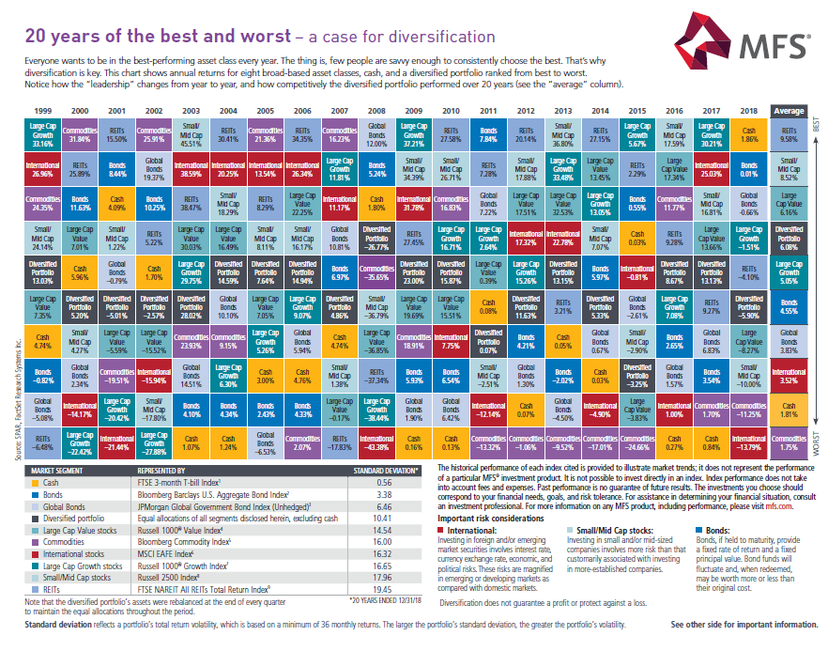
Notes:
[chart from Disciplined Diversification piece: MFSP-20YRSB-FLY (13453)
YOU MUST ACCOMPANY THIS SLIDE WITH A HANDOUT OF THE PIECE ENTITLED 20
YEARS OF THE BEST AND WORST MFSP-20YRSB-FLY (13453)
Speaking of diversification. In a perfect world, everyone would be in the best‐performing asset class all the time.
Unfortunately, few people – if any – are savvy enough to choose the best performers year in, year out, each year, every year.
In this slide, we see annual returns from 1999 through 2018 for eight broad‐based asset classes ranked from best to worst each year.
See a trend?
No. That’s right, because there isn’t one. Notice how often the “leadership” changes and how “strategies” of chasing performance, trying to time the market, or putting all your eggs in one basket would not have worked in your favor. In fact, as you can see, the past 20 years have provided only one certainty in the investment world. Change! But the key is to STAY diversified, regardless of what the market is doing.
While diversification cannot assure a gain or protect against losses in a declining market, it does provide the discipline to invest even when the markets are lower.

Slide 34
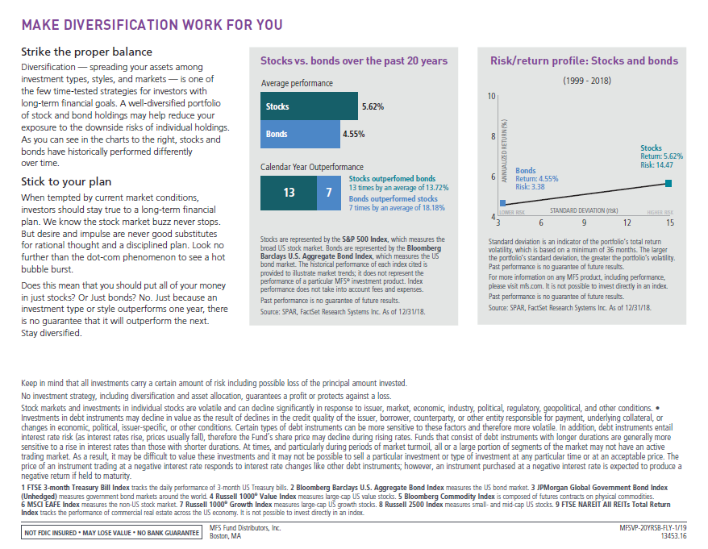
Notes:
MFSP-20YRSB-FLY (13453)

Slide 35
CREATE YOUR STRATEGY TODAY
1
Identify your needs
2
Meet with your advisor
3
Build your plan
Notes:
Alternative closing slide for presenter:
Your next steps are:
Identify your needs
Meet your advisor (schedule an appointment)
Build your foundation (start planning today)
Here’s how to get the conversation started with your advisor. You each have in front of you a form that lists different concerns you may have right now. Please fill out this form (Women Investor: What Keeps You Up at Night Checklist: MFSP-CKLSTWM-FLY- 39140) and hand it to your financial advisor. You can then sit down together to discuss your current and future financial needs – and how to meet them.
And if you want to continue learning and feeling empowered to own your finances, MFS Heritage Planning program offers a suite of resources to help you navigate many of the life events we discussed today. Reach out to your advisor for copies.
Thank you very much and have a great rest of your day.

