Slide 1
Opportunity Zones
Jason E. Richards

Slide 2
1031 Exchange?
Is it the same as a 1031 exchange? NO
Deferral of Gain, Not Complete Avoidance
45 Days to Identify
180 Days to Close
Must Spend the Same or More for 100% Deferral

Slide 3
Opportunity Zone
Deferral of Gain and Potential Future Avoidance
180 Days to Buy Replacement
For 100% Deferral, Must Reinvest 100% of Gain
Deferral Through December 31, 2026
After 10 Years, No Future Taxes on Additional Appreciation…EVER!
Reduction in Deferred Gain No Longer Available

Slide 4
Opportunity Zone
All Capital Gains Qualify
Depreciation Recapture Can Not Be Deferred
Only Re-invested Capital Gain Qualifies
Partners Can Make Separate Decisions
Self Certification: File Form 8996 To Become A Qualified Opportunity Fund

Slide 5
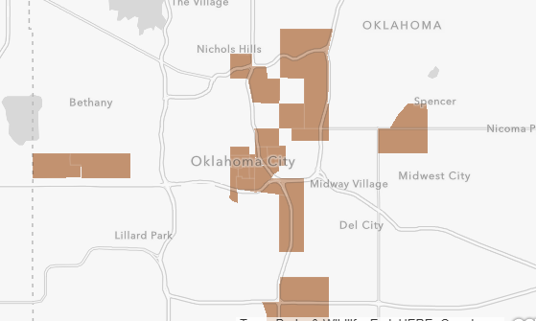
Opportunity Zones

Slide 6
Mechanics

Slide 8
Questions….
JASON E. RICHARDS (405) 235-6500
Jason@resolutionlegal.com

