Slide 1
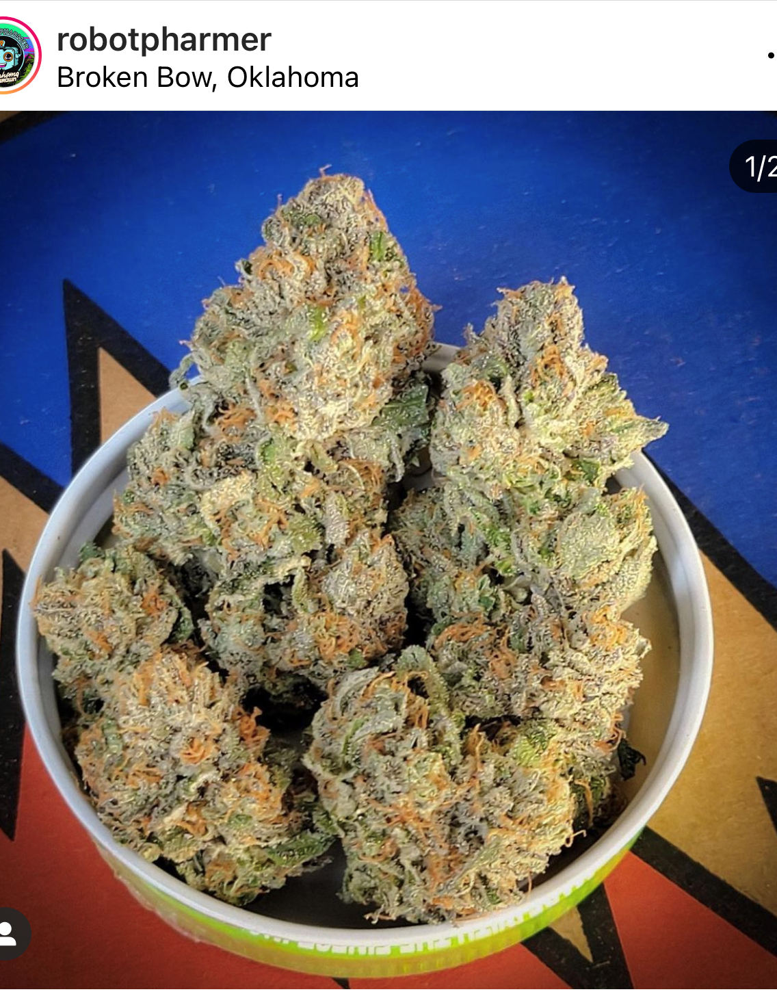
Business & Estate Planning for Clients in the Cannabis Industry
Christopher W. Cotner
chris@bethanylaw.com
405-709-4441

Slide 2
IT IS ILLEGAL
“Medical marijuana does not exist in the United States. Federal law still broadly criminalizes manufacturing, distributing, and possessing marijuana. It is punishable by up to life imprisonment to “knowingly or intentionally . . . manufacture, distribute, or dispense, or possess with intent to manufacture, distribute, or dispense, a controlled substance.” (21 U.S.C. § 841(a).)
Being the owner, operator, financier, banker, landlord, or vendor for a marijuana business is illegal. In addition to the potential life felony for dealing in marijuana, it is a separate federal crime, punishable by up to 20 years in prison, to manage or control any place, permanently or temporarily, for the purpose of manufacturing, distributing, storing, or using marijuana.

Slide 3
IT IS ILLEGAL
Federal money laundering laws also apply to certain common financial transactions with legal marijuana businesses. For example, merely receiving a payment of more than $10,000 from a known marijuana business may be a federal crime punishable by up to 10 years in prison. (18 U.S.C. § 1957.)
Engaging in a financial transaction for the purpose of promoting or furthering a known marijuana business may be a federal crime punishable by up to 20 years in prison. (18 U.S.C. § 1956.)
Even without a prosecution, the government can take your assets. Even if there is no prosecution, there is enormous risk that assets will be seized and forfeited. Civil forfeiture laws allow the government to take all of the assets involved in operating the marijuana business and any property traceable to proceeds of the business. (18 U.S.C. §§ 981, 983.)

Slide 4
IT IS ILLEGAL
Ancillary service providers to legal marijuana businesses take on tremendous risk in addition to possible enforcement action by the federal government. Liability insurance policies normally contain exclusions for criminal acts. Further, an ancillary service provider may have no liability coverage should it be sued for conduct related to its interactions with the legal marijuana business.
Lawyers, accountants, doctors, and other professionals could see their malpractice coverage disappear. Similarly, senior executives of private equity funds, hedge funds, and corporate entities affiliated with legal marijuana businesses may breach their governing documents or their fiduciary duties by engaging in illegal activity, without the protection of director and officer liability coverage.

Slide 5
Oklahoma law on cannabis businesses
Statutory Scheme: 63 O.S. §420 - §427.24
Regulatory Scheme: Title 310, Chapter 681
https://oklahoma.gov/content/dam/ok/en/omma/docs/rules/rules-table/2021.11.23_OSDH681_OMMARulesChapterAsAmended.pdf
Original Text of SQ 788
https://www.sos.ok.gov/documents/questions/788.pdf
SQ 788 Passed: 56.85% to 43.14%
OBNDD
Oklahoma Department of Agriculture
Oklahoma Uniform Building Code
Oklahoma Department of Health Food Manufacturing/Food Handling

Slide 6
TYPES OF Cannabis Businesses
1. Dispensary
2. Grower
3. Processor
4. Research
5. Testing Labs
6. Transporter
7. Waste Management

Slide 7
APPLICATION process (generally)
Fee: $2,500 for each type of license
Required Information/Documentation
(1) A list of all owners and principal officers of the business applicant and supporting documentation, including, but not limited to: certificate of incorporation, bylaws, articles of organization, operating agreement, certificate of limited partnership, resolution of a board of directors, or other similar documents;
(2) If applicable, a certificate of good standing from the Oklahoma Secretary of State issued within thirty (30)days of submission of the application;
(3) If applicable, official documentation from the Secretary of State establishing the applicant's trade name;
(4) If applicable, an electronic copy or digital image in color of a sales tax permit issued by the Oklahoma Tax Commission;
(5) An Affidavit of Lawful Presence for each owner;
(6) If a licensed dispensary, proof that the location of the dispensary is at least one thousand (1,000) feet from a public or private school.

Slide 8
APPLICATION process (generally)
(8) If applicable, a certificate of compliance on a form prescribed or otherwise authorized by the Department that is issued by the political subdivision where the licensed premises is to be 2021.11.23_OSDH681_OMMARulesChapterAsAmended 54 located certifying compliance with the categories listed in 63 O.S. § 426.1(E);
(9) If applicable, accreditation documentation, including documentation of enrollment in analyte-specific proficiency testing results, showing applicants meet requirements stated in OAC 310:681- 8-2(a);
(10)If a licensed grower, processor or transporter has added or is seeking to add a publicly traded company as an owner, additional documentation as required under OAC 310:681-5-2(e)(2)(C) to show the grower, processor, or transporter applicants meet the requirements stated in 63 O.S. § 427.15a;
(11) If applicable, a list of all chemicals a processor will utilize to process marijuana;
(12) If applicable, safety data sheets for every chemical a processor will utilize to process marijuana; and
(13) Any further documentation the Department determines is necessary to ensure the commercial applicant is qualified under Oklahoma law and this Chapter to obtain a commercial license.

Slide 9
APPLICATION process (generally)
Disclosure of Owners
"Owner" means, except where the context otherwise requires, a direct beneficial owner, including, but not limited to, all persons or entities as follows:
(A) All shareholders owning an interest of a corporate entity and all officers of a corporate entity;
(B) All partners of a general partnership;
(C) All general partners and all limited partners that own an interest in a limited partnership;
(D) All members that own an interest in a limited liability company;
(E) All beneficiaries that hold a beneficial interest in a trust and all trustees of a trust;
(F) All persons or entities that own interest in a joint venture;
(G) All persons or entities that own an interest in an association;
(H) The owners of any other type of legal entity; and (I) Any other person holding an interest or convertible note in any entity which owns, operates, or manages a licensed medical marijuana facility.

Slide 10
APPLICATION process (SPEFICIALLY)
The following persons are prohibited from being an “Owner:”
(1) An applicant who has failed to pay the required application or renewal fee;
(2) A corporation, if the criminal history of any its officers, directors, or stockholders has a disqualifying criminal conviction;
(3) An owner under twenty-five (25) years of age;
(4) An owner of any commercial licensee who, during a period of licensure or at the time of any commercial license application, has failed to: (A) File any taxes, interest, or penalties due related to a medical marijuana business; or (B) Pay any taxes, interest, or penalties due related to a medical marijuana business.
(5) A sheriff, deputy sheriff, police officer, prosecuting officer, officer or employee of OMMA, or officer or employee of a municipality in which the commercial licensee is located; and
(6) A person whose authority to be a caregiver as defined in this Chapter is revoked by the Department for violations of Oklahoma law or these Rules. For purposes of this Subsection, revoked by the Department shall not include termination of a caregiver license based solely on a patient's withdrawal of caregiver designation
(7) A person who was involved in the management or operation of any commercial licensee that, after the initiation of a disciplinary action, has had a medical marijuana license revoked, not renewed, or surrendered during the five (5) years preceding submission of the application and for the following violations: (A) unlawful sales or purchases; (B) any fraudulent acts, falsification of records or misrepresentation to the Department, medical marijuana patient licensees, caregiver licensees, or medical marijuana business licensees; (C) any grossly inaccurate or fraudulent reporting; (D) threatening or harming any medical marijuana patient, caregiver, medical practitioner, or employee of the Department; (E) knowingly or intentionally refusing to permit the Department access to premises or records; (F) using prohibited, hazardous substance for processing in a residential area; (G) criminal acts relating to the operation of a medical marijuana business; or 2021.11.23_OSDH681_OMMARulesChapterAsAmended 56 (H) any violations that endangers public health and safety or product safety, including, but not limited to, failure to test medical marijuana or medical marijuana products in accordance with these rules, failure to assist in a recall or embargo, or failure to adhere to any order or directive by the Department that may endanger public health and safety

Slide 11
APPLICATION process (SPEFICIALLY)
(3) An owner under twenty-five (25) years of age;
Vs.
(E) All beneficiaries that hold a beneficial interest in a trust and all trustees of a trust;
OMMA has NOT published guidance on what this means.
The word “death” does NOT appear in the statutes or regulatory scheme – except in one place: 12 O.S. §1560

Slide 12
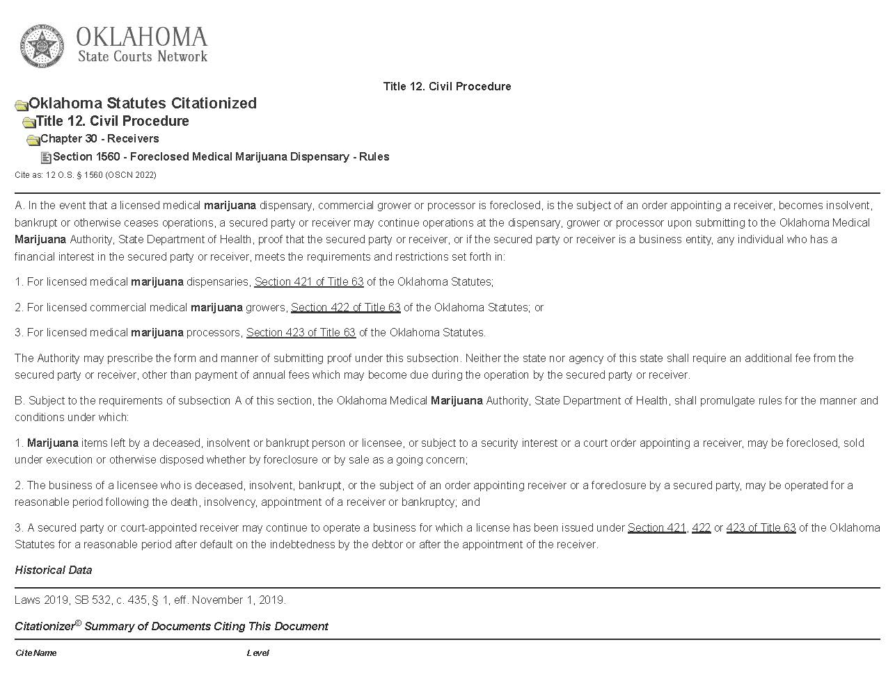

Slide 13
POST Disability/DEATH PLANNING
(a) In the event that a licensed dispensary, grower, or processor is foreclosed, is the subject of an order appointing a receiver, becomes insolvent or bankrupt, or otherwise ceases operations, a temporary Certificate of Authority may be issued to a secured party, court appointed receiver, trustee, court-appointed personal representative, or other individual determined by the Department to have legal authority over the operation and/or disposition of the assets of the licensee. The temporary Certificate of Authority shall authorize the holder to continue operation, without obtaining a separate license, at a licensed dispensary, grower, or processor for a reasonable period of time for the orderly disposition of the business.
(b) A secured party, court-appointed receiver, trustee, personal representative, or other person requesting a Certificate of Authority must meet the requirements set forth in OAC 310:681-5-3 and OAC 310:681-5-3.2. A party that is issued a Certificate of Authority is subject to the same restrictions and obligations as any commercial licensee.
(c) A person requesting a temporary Certificate of Authority shall submit the form documentation provided by the Department in a manner prescribed by the Department.
(d) There shall be no additional fee for a Certificate of Authority to operate a grower, processor, or dispensary.

Slide 14
POST Disability/DEATH PLANNING
(e) A request for Certificate of Authority shall include the following documentation:
(1) Documents establishing proof of identity as established in OAC 310:681-1-7(b) (relating to proof of identity);
(2)If applicable, a list of all owners and principal officers of the applicant and supporting documentation, including, but not limited to: certificate of incorporation, bylaws, articles of organization, operating agreements, certificate of limited partnership, resolution of a board of directors, or other similar documents;
(3) Documents establishing the applicant, the members, managers, and board members, if applicable, and seventy-five percent (75%) of the ownership interests are Oklahoma residents as established in 63 O.S. § 420 et seq., and OAC 310:681-1-6 (relating to proof of residency;
(4) A criminal background check conducted by the Oklahoma State Bureau of Investigation establishing that the applicant does not have a disqualifying criminal conviction.
(5) A receiver, personal representative, or trustee must provide the Department with the following information:
(A) Official documentation proving that the person is the legal trustee, receiver, or personal representative for the business, or otherwise has legal authority over the operation and/or disposition of assets of the licensee, such as a court order, letters of administration, or other official documentation the Department deems sufficient.
(B) Any further documentation the Department determines is necessary to ensure the secured party is qualified under Oklahoma law and this Chapter.

Slide 15
POST Disability/DEATH PLANNING
Challenges:
1. How much work do we want to do on these issues knowing that at any time soon (5-10 years) that all of our work could go up in smoke if Marijuana is de-scheduled from a Schedule 1 drug, de-criminalized, or legalized at the federal level?
2. Single owner Cannabis Business – how to do succession planning?
3. Multi owner Cannabis Business – how to structure a buy/sell agreement?
4. Corporate Trustees – can they even accept an appointment?
5. Taxes – 280E
6. What is the risk of accepting accounts for management that you know or should know are proceeds from a marijuana business (if federal law still makes it illegal)?

